Slide 1


AIoT-Based Smart Climate-Aware Greenhouse System for Sustainable Agriculture
Muhammad Maaz
Muhammad Talha Khan
Muhammad Ibad Khan
Department of Computer Systems Engineering
University of Engineering & Technology Peshawar

Slide 2
The Problem: The Inconsistency of Traditional Agriculture
Inconsistency and Delay: Traditional plant care suffers from inconsistency and delayed intervention, often leading to crop loss or suboptimal yields.
Lack of Precision: Environmental factors require constant, precise management that is difficult to achieve manually.
Reactive Intervention: Disease detection is often reactive, occurring only after visible symptoms have caused significant damage, limiting medicinal or high-value crop viability.
Resource Inefficiency: Irrigation and climate control are often managed inefficiently, wasting water and energy.

Slide 3
OBJECTIVES
Platform Development: Build a robust Internet of Things (IoT) hardware platform for real-time environmental sensing and automated device control (pumps, fans).
Intelligent Control: Train a Machine Learning (ML) model to intelligently dictate automated control actions based on sensed data.
Early Disease Detection: Implement real-time leaf image classification for early detection and alerting of plant diseases.
Global Adaptability: Develop a system capable of storing seasonal data and using it to configure optimal growing parameters for medicinal and specialty plants in diverse global regions.
User Interface: Provide a comprehensive, cross-platform mobile application and web dashboard for remote monitoring, analysis, and control.

Slide 4
Literature Review / Background
Project Focus: AIoT-Based Smart Climate-Aware Greenhouse System for Sustainable Agriculture.
Technology Stack: The project utilizes the Artificial Intelligence of Things (AIoT) framework, combining IoT sensing with Edge AI processing.
Core Principle: Addressing the need for precise environmental control through automation and data-driven decision-making.
System Foundation: Building an IoT hardware platform for sensing and control.
Scalability: Designed to be easily expanded to multiple greenhouses with a single central hub (Raspberry Pi).

Slide 5
Methodology: Automated Sensing and Intelligent Actuation
Sensing: Uses a soil moisture sensor to check moisture level and a DHT22 for temperature and humidity.
Irrigation Control: When soil moisture drops, the motor turns on and activates the irrigation system.
Climate Control: When temperature gets high, the servo motor and fan turn on. The fan speed adjusts automatically.
Communication: NRF modules are used for wireless data transmission between the node and the Raspberry Pi.
Intelligent Control: An ML model dictates the control actions (pump, fan, ventilation) intelligently.

Slide 6
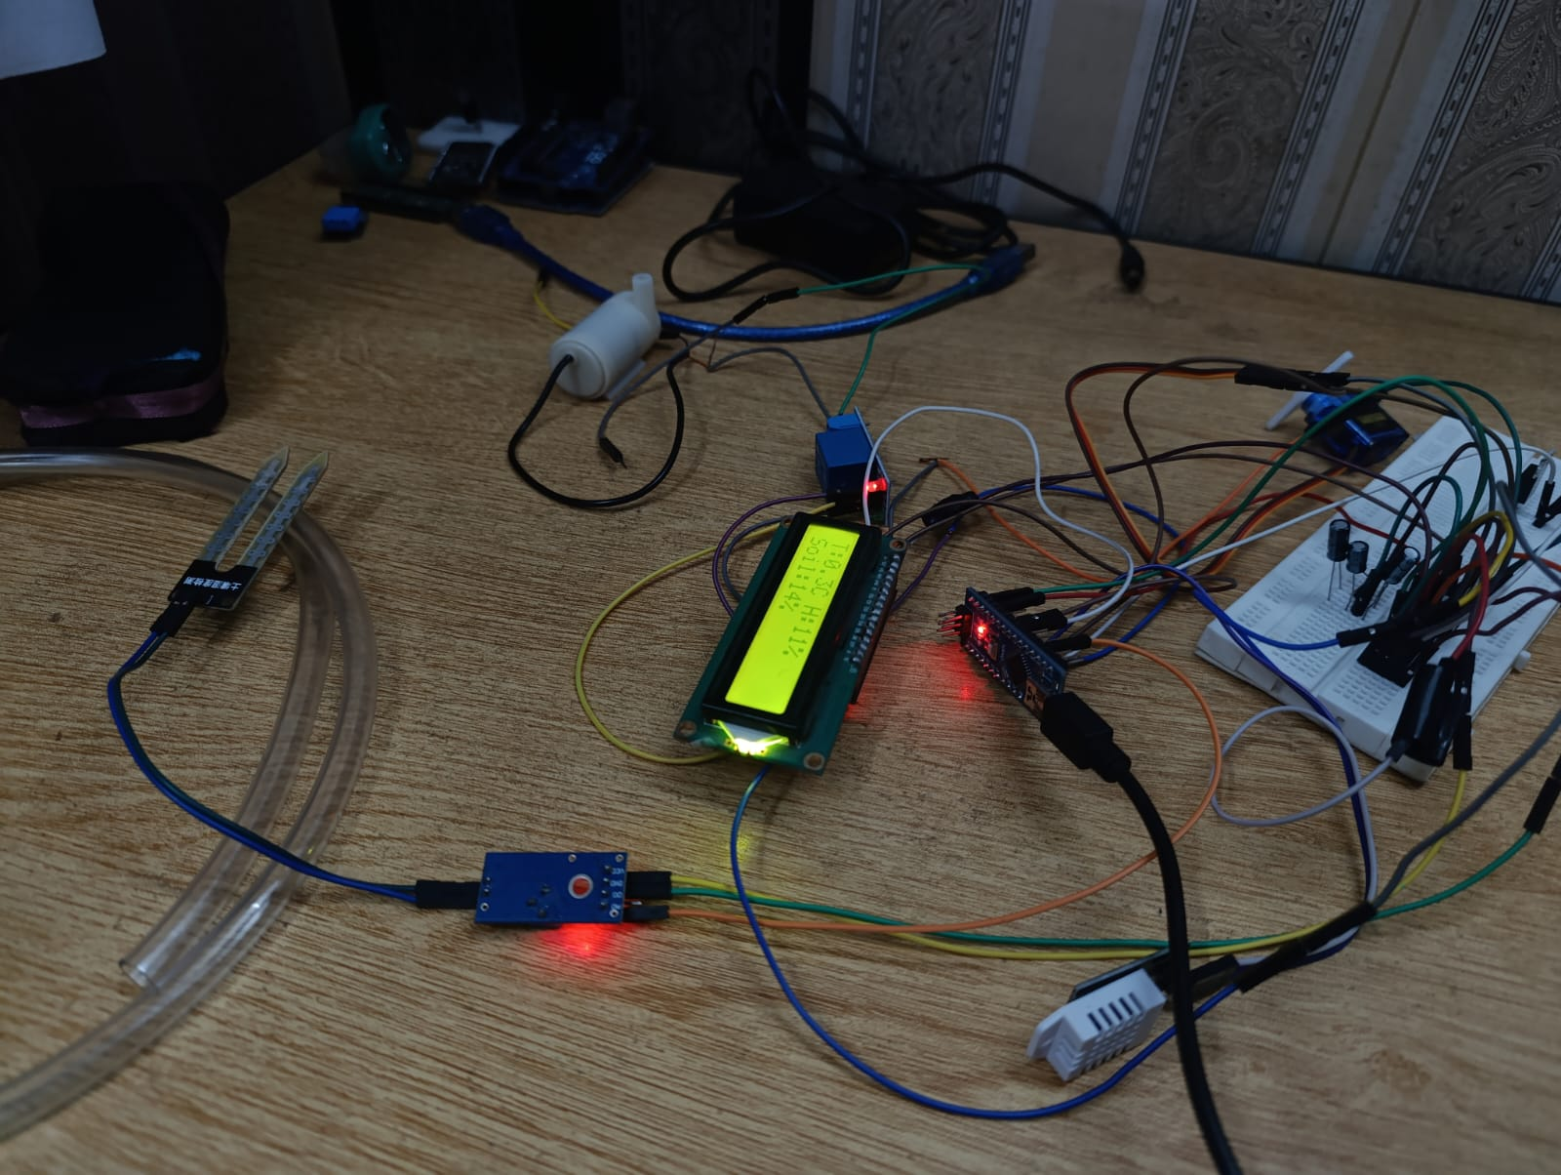
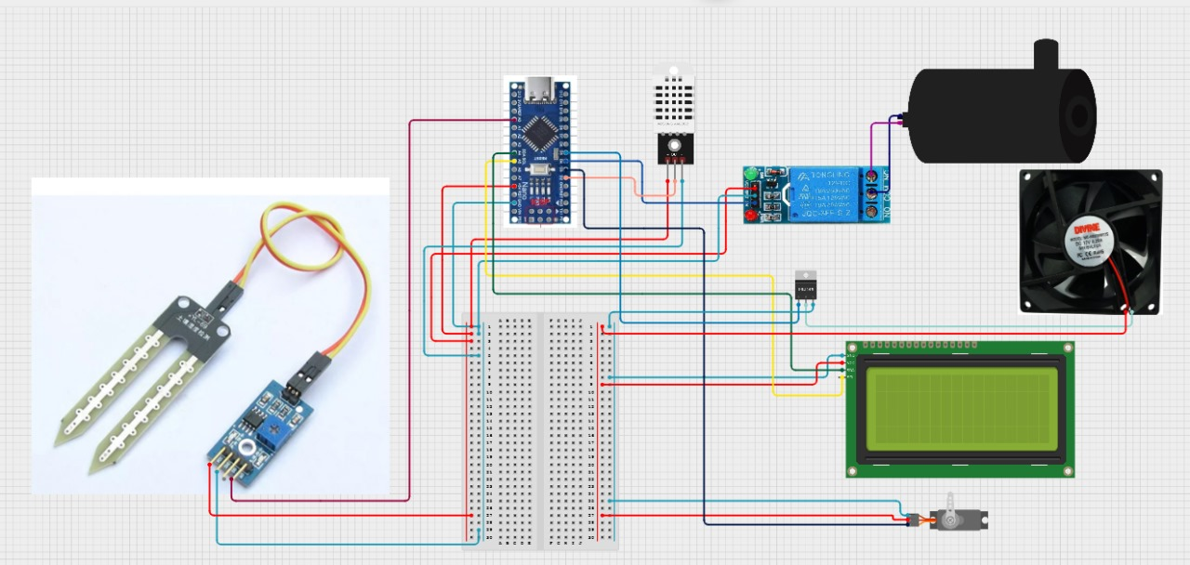
Automation System

Slide 7
System Architecture: Edge AI Gateway and Multi-Node Scalability
Sensor Node: Microcontroller collects sensor data (Moisture, Temp/Humidity) and controls actuators (Pump, Fan).
Wireless Link: NRF Transceiver sends data wirelessly.
Edge AI Gateway: Raspberry Pi receives data from NRF nodes and executes the optimized ML model.
Cloud Interface: Firebase Dashboard provides real-time monitoring and logging.
User Interface: Flutter mobile app enables remote control and data visualization.

Slide 8
Technologies & Tools Used
Component/Phase | Technology/Tool | Role in System
Edge Hardware | Raspberry Pi | The resource-constrained host, performing all processing on-device (Edge AI).
Model Runtime | TensorFlow Lite (tflite_runtime) | Lightweight core library for executing the optimized ML model on the Pi's ARM CPU.
Data & Cloud | Firebase Studio | Real-time, cloud-based monitoring interface.
Video Processing | OpenCV (cv2) | Handles real-time camera stream and pre-processing (e.g., resizing to 224×224 pixels).
User Interface | Flutter | Used to build a modern, intuitive, cross-platform interface (Android/iOS).
Communication | NRF Modules | Enables wireless data transfer and scalability to multiple greenhouses.

Slide 9
ML Data: Control and Image Pre-processing
Control Data:
Description: Sensor readings (Moisture, Temp, Humidity) mapped to actuator states (Pump ON/OFF, Fan ON/OFF, Ventilation ON/OFF).
Goal: Train a classification model for intelligent decision-making.
Image Data (for Disease Detection):
Description: Images of plant leaves for health classification.
Preprocessing: The real-time camera stream is handled by OpenCV. Captured frames are resized to 224 times 224 pixels before being fed to the TensorFlow Lite model.
Training Outcome: The model was trained successfully with accuracy stabilizing around 74% and loss minimizing very quickly

Slide 10
Machine Learning for Control and Detection
Model Type: Classification model for control actions and image classification for health monitoring.
Control Logic: The model determines the optimal ON/OFF state for the Pump, Fan, and Ventilation based on sensor data.
Deployment: Model is optimized and executed on the resource-constrained Raspberry Pi using TensorFlow Lite (Edge AI).
Reliability: The model demonstrated high reliability in control, with validation metrics closely mirroring training metrics (no catastrophic overfitting).

Slide 11
Core Features: Automation, Edge AI, and Remote Management
Intelligent Automation: ML-dictated control of irrigation (Pump) and climate (Fan/Ventilation).
Real-Time Dashboard (Firebase): Cloud-based monitoring showing live KPIs and a Leaf Health Index.
Early Disease Detection (Edge AI): Real-time image classification on the Raspberry Pi identifies plant health issues.
Mobile App: Cross-platform access for remote management, data visualization, and early alarming.
Scalability: System can be expanded to manage multiple NRF nodes across multiple greenhouses.

Slide 12
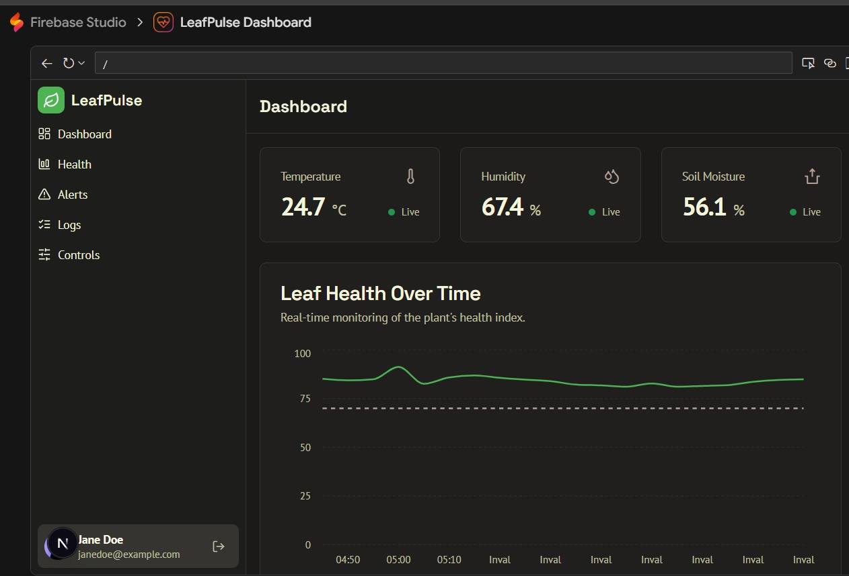
Firebase Dashboard

Slide 13
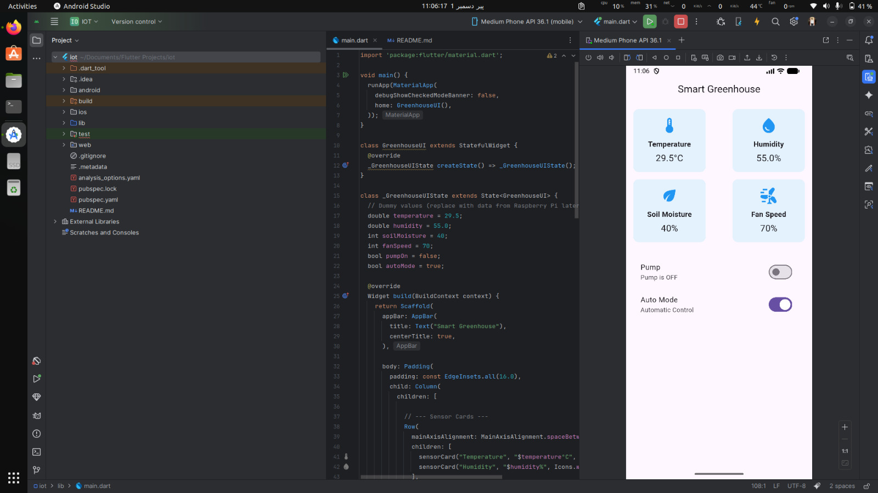
App Dashboard
User Interface (UI)
Cross-Platform Interface (Flutter):
1) The system uses Flutter to build a modern, intuitive Smart Greenhouse application. This allows the same codebase to run on both Android and iOS, providing wide accessibility for monitoring.
2) Real-Time Data Visualization: The mobile app displays key sensor metrics in real-time, including Temperature, Humidity, Soil Moisture, and Fan Speed. This gives the user immediate visibility into the greenhouse environment.
3) Remote Control and Automation: The application includes toggle controls (switches) for activating components like the Pump and setting the system to Auto Mode (Automatic Control), allowing users to remotely manage the greenhouse conditions.

Slide 14
Prototype Output: Live Dashboard and Mobile Interface
Dashboard Display:
Shows current conditions:
  Temperature: 24.7∘C
  Humidity: 67.4%
  Soil Moisture: 56.1%
Mobile App Interface:
Displays sensor metrics:
  Temperature: 29.5∘C
  Fan Speed: 70%
Provides toggles for:
  Pump
  Auto Mode
Terminal Output (Raspberry Pi):
Shows system processes and package installations:
  OpenCV
  Debian Trixie

Slide 15
System Deployment and Validation
Hardware Implementation: Successfully implemented the IoT hardware platform, integrating sensors, actuators, and NRF wireless communication.
Model Training and Deployment: Trained the ML model and deployed it on the Raspberry Pi using TensorFlow Lite for intelligent control actions.
System Reliability: Achieved a model accuracy of 74.6%, with control decisions demonstrating extremely high reliability (AUC = 1.00) on the test set.
User Interface: Developed a functional Firebase dashboard and a cross-platform Flutter mobile application for real-time monitoring and remote control.

Slide 16
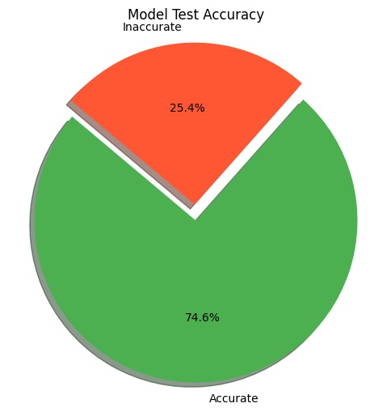
Accuracy

Slide 17
Results & Evaluation
Overall Test Accuracy: 74.6%.
Control System Accuracy: The ML model achieved extremely high accuracy and low error rates for all three control systems (Pump, Fan, Ventilation).
ROC Curve (AUC): 1.00 for Pump, Fan, and Ventilation.
Precision-Recall: Average Precision = 1.00 for Pump, Fan, and Ventilation.
Conclusion: These scores indicate the model is making the correct control decisions (ON/OFF) based on sensor data with virtually perfect accuracy on the test set.

Slide 18
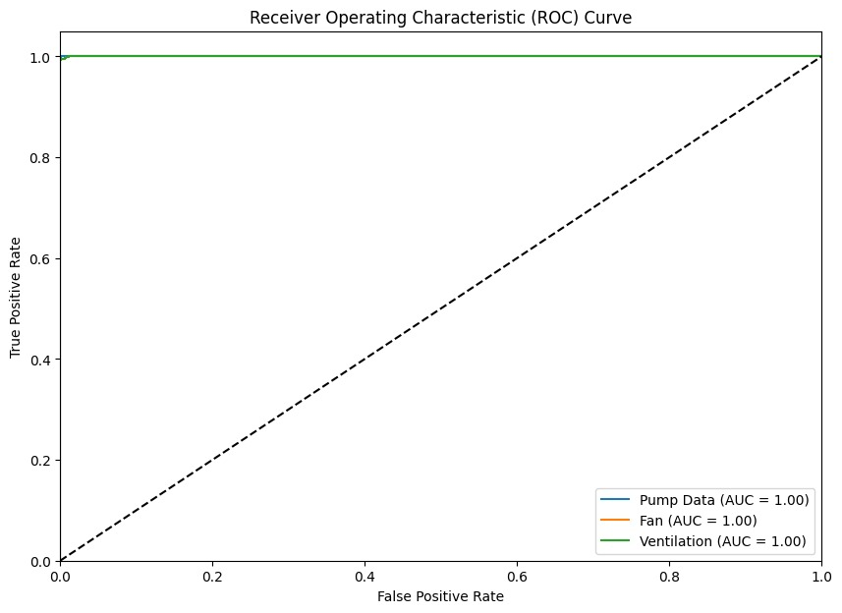
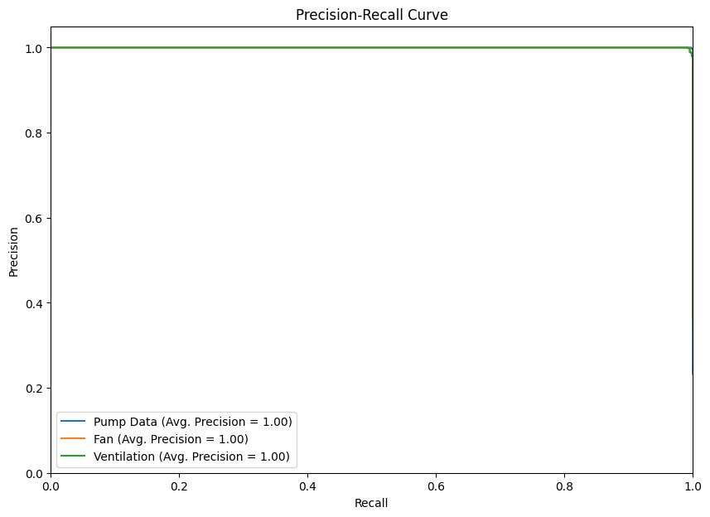
ROC Curve and Precision-Recall curve

Slide 19
Key Challenges in AIoT Deployment
Hardware Implementation: Successfully implemented the IoT hardware platform, integrating sensors, actuators, and NRF wireless communication.Hardware Integration: Integrating diverse components (Arduino/microcontroller, Raspberry Pi, NRF modules, relays, sensors) into a cohesive, reliable system.
Model Optimization for Edge: Optimizing the machine learning model (e.g., for image classification) to run efficiently on the resource-constrained Raspberry Pi CPU using TensorFlow Lite.
Data Reliability: Ensuring the consistency and integrity of sensor data transmitted wirelessly via NRF modules.
Scalability Management: Configuring a single Raspberry Pi to efficiently manage data and commands from multiple NRF nodes/greenhouses.
Model Training and Deployment: Trained the ML model and deployed it on the Raspberry Pi using TensorFlow Lite for intelligent control actions.
System Reliability: Achieved a model accuracy of 74.6%, with control decisions demonstrating extremely high reliability (AUC = 1.00) on the test set.
User Interface: Developed a functional Firebase dashboard and a cross-platform Flutter mobile application for real-time monitoring and remote control.

Slide 20
Expanding to Global and Predictive Agriculture
Seasonal Data Repository: Implement storage and analysis of seasonal data to establish and optimize growth "recipes" for specific medicinal plants.
Global Adaptability: Develop logic to use stored seasonal data to automatically adjust greenhouse parameters based on a region's current climate, enabling global crop viability.
Predictive Maintenance: Incorporate advanced time-series analysis to predict component failures or required environmental adjustments.
Enhanced Sensing: Add support for more advanced sensors (e.g., pH, CO_2 concentration) for holistic crop management.

Slide 21
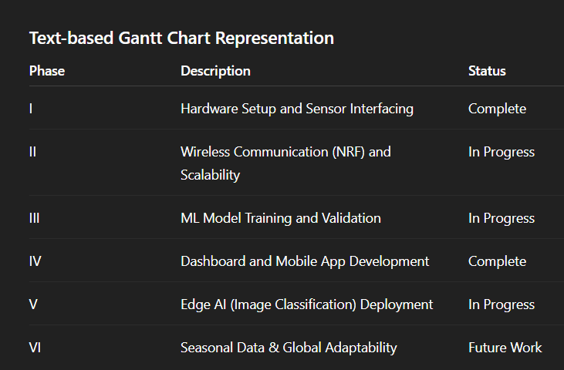
Project Phases and Progress (Estimated Timeline)

Slide 22
Conclusion: AIoT for Sustainable Precision Agriculture
System Success: We successfully developed and validated an AIoT-Based Smart Climate-Aware Greenhouse System.
Precision Control: The system delivers consistent, precise environmental management using a highly reliable ML control model (AUC= 1.00).
Key Features: Integrated with scalable wireless communication, a real-time monitoring dashboard, and a cross-platform mobile app for remote management and alarming.
Impact: This platform enables the sustainable and efficient cultivation of high-value and medicinal plants by mitigating environmental inconsistency and facilitating global crop viability.

Slide 23
Thank You

